Slide 1

Databases
Lecturer
Rokas Slaboševičius
Data

Slide 2
Today you will learn
Databases
What are databases?
01
What are database management languages?
02

Slide 3
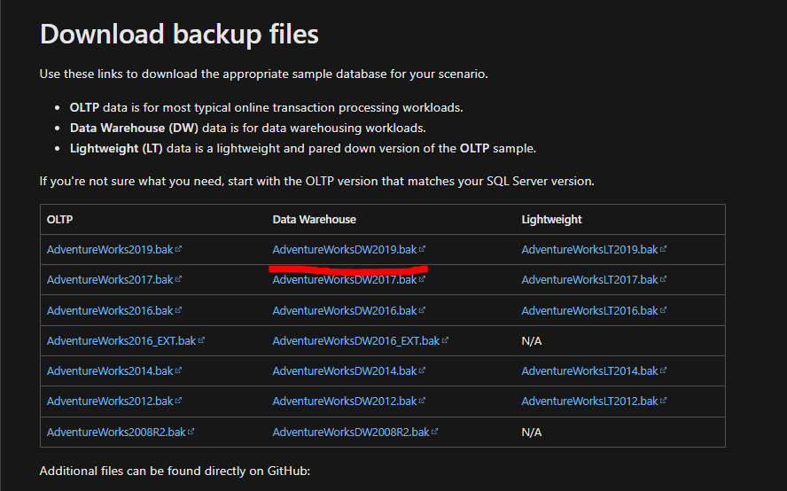
What is a database?
Databases
Database used:
https://docs.microsoft.com/en-us/sql/samples/adventureworks-install-configure?view=sql-server-ver15&tabs=ssms

Slide 4
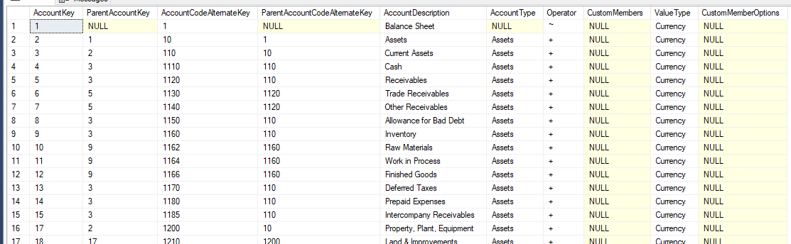
What is a database?
Databases
Database (DB) - a collection of interrelated data that a computer is used to process.
Such a DB is similar to a spreadsheet:

Slide 5
What is a database?
Databases
Users of a similar DB perform the following operations:
Adding a new entry
Modifying an existing record
Deleting an existing entry
Searching for data in the database
A computer system that performs similar operations is called a database system (DBS).
A DBMS that enables a DB user to work with a DB without regard to technical details is called a database management system (DBMS)

Slide 6
What is a database?
Databases
A DBMS allows the user to view the DB as a much higher level object than a record file, which is the main purpose.
The DBMS plays the role of the user interface to the DB. Users operate the DB using a formal language, e.g. SQL.

Slide 7
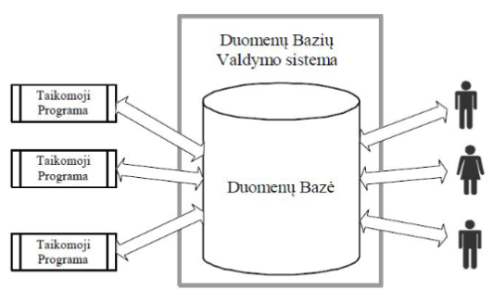
DBS users
Databases

Slide 8
Relational DB
Databases
A DBMS allows the user to use logical concepts.
The set of concepts and the rules for their use is the model.
Most DBMSs use a relational data model - E.F. E.F. Codd, IBM.
DBs that are defined using a relational model are called relational databases (RDBs).
Their corresponding management systems are relational database management systems (RDBMS).

Slide 9
Relational DB
Databases
Basic concepts of a relational model:
table(table)
string (row)
column
The relational system is based on the following basic principles:
The data is presented to the user in tables and in no other way.
Operators are provided to allow the user to retrieve new tables from existing ones.

Slide 10
Relational DB
Databases
An RDB is a DB that users perceive as a collection of tables.
A row in the table describes a single object - a person, a company, a car...
Column - the characteristics of the object - the person's surname, first name...
The intersection of a row and a column is the value (field).

Slide 11
Relational DB
Databases
Currently among the most widespread and developed RDBMS:
IBM DBMS DB2
Oracle DBMS ORACLE
Microsoft DBMS SQL Server
Sybase Inc. DBVS - SYBASE SAP
PostgreSQL - open source
MySQL - open source

Slide 12
SQL
Databases
SQL is a declarative (non-procedural) programming language.
There are three groups of sentences in the language:
Data Definition Language (DDL) (Data Definition Language)
Data Manipulation Language (DML)
Data Control Language (DCL).
SQL = DDL + DML + DCL

Slide 13
SQL
Databases
DDL sentences are used to create DBs and tables. When a DB is created, its name, physical location, etc. are specified.
Creating a table - table name, column names and column types.
SQL data types: text data, numbers, binary data, dates and times. Each type with its physical implementation properties is considered a data type. Each data type contains a special value NULL to indicate that the data is unknown, not yet entered, already removed, etc.
DML sentences are used to form queries to find, remove and insert data.
DCL sentences coordinate the work of users with the DB.

Slide 14
Data extraction
Databases
The SELECT statement is used to select records from one or more tables.
The FROM statement specifies the tables from which the rows are to be extracted (relationships can be specified with different JOIN variants).
The WHERE statement specifies the condition that must be met by the returned rows.
The GROUP BY clause specifies that certain rows are to be grouped. When grouping rows, aggregate functions are commonly used to extract maximum, average and similar values from the grouped rows

Slide 15
Data extraction
Databases
The ORDER BY statement specifies one or more sort conditions.
The HAVING statement specifies the criterion applied to the grouped rows;
The HAVING keyword can only be used if the query contains a GROUP BY statement.

Slide 16
Data extraction
Databases
INSERT is used to insert new records into a table.
DELETE allows you to delete entries from the table.
UPDATE is used to change the values of one or more records.

Slide 17
Data extraction
Databases
The SELECT statement is used to select data from the database. The results are returned in the form of a table, which is called Result-Set.
The syntax of a SELECT statement:
SELECT field_names FROM table_name;
or
SELECT * FROM table_name;
* - means all fields

Slide 18
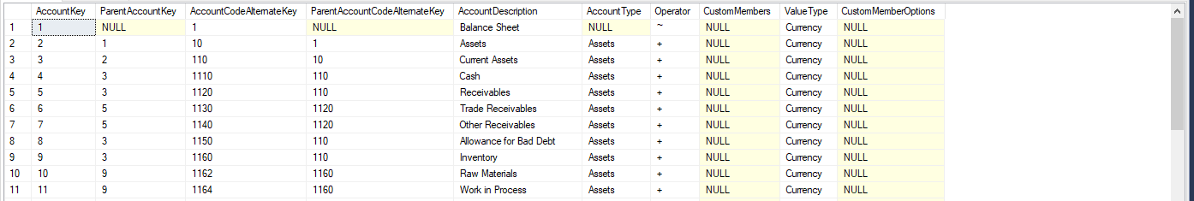
Data extraction
Databases
Example table with fields:

Slide 19
Data extraction
Databases
The statement SELECT * FROM [DimAccount]; will retrieve all accounts from the table "DimAccount";
Sentence: SELECT [DimAccount].[AccountKey],[DimAccount].[AccountDescription] FROM [DimAccount]; retrieves AccountKey and AccountDescription from the "DimAccount" table

Slide 20
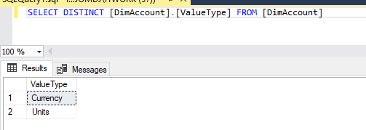
Data extraction
Databases
DISTINCT - selecting different values.If you know that your sentence will select duplicate data and you want to see only unique values, you can use the DISTINCT keyword in your SELECT clause.Suppose you want to see all the different ValueTypes in the DimAccount table, but you don't want to see the duplicates:

Slide 21
Data extraction
Databases
Data manipulation commands allow you to insert data into or remove data from the database. It is also possible to correct data and leave it there. There are three main operations on data that can be performed by the user, provided that the user has been granted
INSERT
UPDATE
DELETE

Slide 22
Data extraction
Databases
UPDATE table_name SET Column1=value1,Column2=value2 WHERE condition;
Multiple rows can be updated at once according to a given condition.Column1, Column2... Column names that need to be replaced with new values
Value1, Value2 are the new column values respectively.
WHERE specifies the condition under which those rows are updated. The condition is optional, but if it is not specified, the change is applied to all rows in the table.

Slide 23
Data extraction
Databases
INSERT INTO table_name(column1,column2) VALUES(value1,value2);
The command will insert value1 into column1, value2 into column2 and so on.
Symbolic data and date-type data are always between single quotes.
INSERT INTO dept(deptno, dname, loc) VALUES(50, 'DEVELOPMENT', 'DETROIT');

Slide 24
Data extraction
Databases
You can also create empty field values during the input process,
This requires excluding the column you want to leave unfilled from the list.INSERT INTO dept(deptno, dname) VALUES(60, 'MIS');The same can be done in another way
INSERT INTO dept VALUES(70, 'FINANCE', NULL);

Slide 25
Data extraction
Databases
DELETE FROM table_name WHERE condition;
An entry that meets the specified condition will be removed from the table under the specified name.
DELETE FROM dept WHERE dname = 'DEVELOPMENT';
If no condition is specified, all rows are deleted.DELETE FROM dept;

Slide 26
Data extraction
Databases
To delete records, you can use a sub-query to retrieve data from another table:
DELETE FROM employee WHERE deptno = (SELECT deptno FROM dept WHERE dname = 'SALES');
EMPLOYEE will remove from the table all employees whose duties are specified in the condition.
You can also delete all entries with the command
TRUNCATE TABLE table_name;
This command physically deletes the entries and cannot restore them.
DROP removes everything: the data along with the table structure.
DROP TABLE table_name;

Slide 27

Databases
Task 1
Select all data from the table “Employee”.
Select all data from the column “PersonalCode” in the table “Employee”.
Select all data from the columns “FirstName”, “LastName”, “Position” in the table “Employee”.
Select distinct values from the column DepartmentName in the table “Employee”.
Select all data about employees who work in the C# department.
Select data on what position Giedrius holds.
Select all data about employees whose birth date is 1986-09-19.
Select employee names whose last names are Sabutis.
Select data (first and last names) about developers from the Java department.

Slide 28
Databases
Task 2
Insert a new employee into the table “Employee”, filling in all required fields (personal code, first name, last name, start date, birth date, position, department name, and project number).
Insert a new employee into the table “Employee”, only filling in fields (personal code, first name, last name, start date, birth date). Leave position, department name, and project number unfilled.
Fill in the remaining empty fields in the table “Employee” for your previously inserted entry. Assign the employee a position, department, and project.
Delete the table “Employee” record whose personal code is the one you created.
Insert two employees with the last name Antanaitis whose position would be “Developer”.
Change the positions of both Antanaitis to “Tester” in one sentence.
Count how many Testers work in the company.

